Slide 1
2025 Budget Discussion
July 23, 2024

Slide 2
2025 PROPOSED BUDGET OPTIONS
  MILL LEVY RATE AT 12.7% INCREASED VALUATION (CURRENT MILLS)
  GENERAL 56.633
  AIRPORT .625
  LIBRARY 5.608
  SPECIAL LIABITY .386
  BOND & INT 9.109
  72.361
  MILL LEVY RATE AT 11% INCREASED VALUATION
  (DECREASE BY 1 MILL)
  GENERAL 55.755
  AIRPORT .625
  LIBRARY 5.521
  SPECIAL LIABITY .351
  BOND & INT 9.109
  71.361
This is a one mill difference or $171,243

Slide 3
Proposed Service Reductions
  Remove 2 New swing sets - $21,000
    Installation of new swing sets at two parks
  Postpone Fire/EMS accreditation - $70,000
    Overall internal assessment of operations of the organization
  Reduce Various trainings and travel- $10,000
    Reduction of items in the Administration budget
  Reduce Salary survey implementation - $49,360
    Wage increases to stay competitive in job market
  Reduce Transfer to Library Fund - $14,889
    Take only an 11% increase in valuation
  Special Liability Fund - $5,994
    Take only an 11% increase in valuation

Slide 4

11% OPTION

Slide 5
12.7% OPTION

Slide 6
12.7% OPTION

Slide 7
11% OPTION

Slide 9
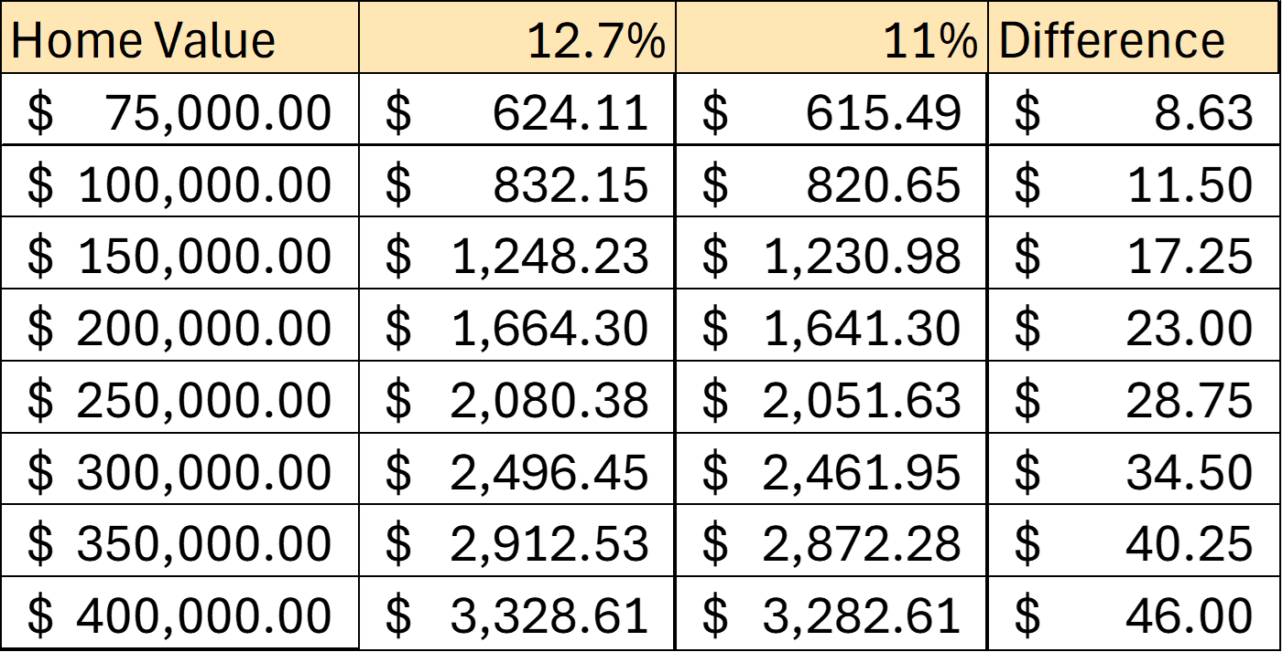
Potential Tax Savings
The difference of Newton portion of taxes in each scenario with 2024 valuations

Slide 10
Proposed 2025 Budget Timeline
July 9 – Set intent to exceed RNR
July 20 or before – Notice to County Clerk
July 23 – Publish Revenue Neutral Rate Public Hearing
July 23 or Aug. 13 – Set not-to-exceed budget for publication
Aug. 27 – Hold RNR & budget public hearings
Approve resolution to exceed RNR
Adopt 2025 budget

Slide 11
Next Steps
Set Not-to-Exceed Budget Expenditures
Set Publication Date for RNR Public Hearing and 2025 Budget Hearing as August 27, 2024

Slide 12
12.7%
Set 2025
Not to Exceed Expenditure Amount

Slide 13
11%
Set 2025 Not to Exceed Expenditure Amount

